Slide 1

JAVA Training
Chapter 3 : TDD
Thomas DECOSTER
Java Senior Consultant
VPTT 2020 4.4.7.4 RC /
1

Slide 2

Agenda
Tests in the development process
Automated tests with the JUnit framework
Principles of TDD
Test writing strategies
Write testable code
Test doubles
Techniques to organize tests
TDD and legacy code
TDD styles
Test coverage
Refactoring with TDD

Slide 3
Tests in the development process > Waterfall and V-cycle

Slide 4
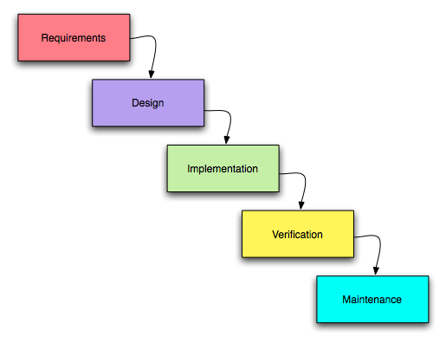
Waterfall
See Winston W. Royce : Managing the development of large software systems (1970)

Slide 5
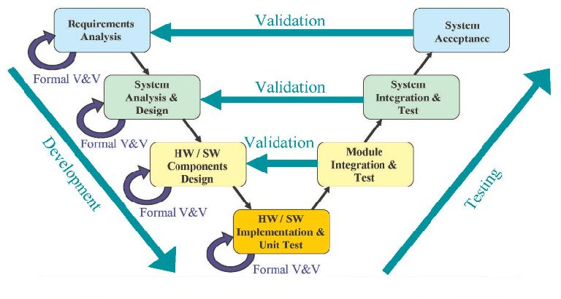
V-Cycle
Tests are written early in the development cycle

Slide 6
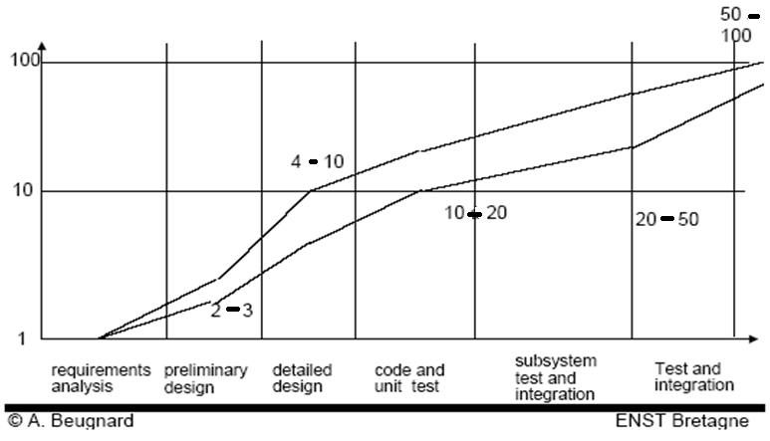
Tests in traditional software developpement
Tests are run late in the development cycle
By a separate test team
Cost of defects repair increases

Slide 7
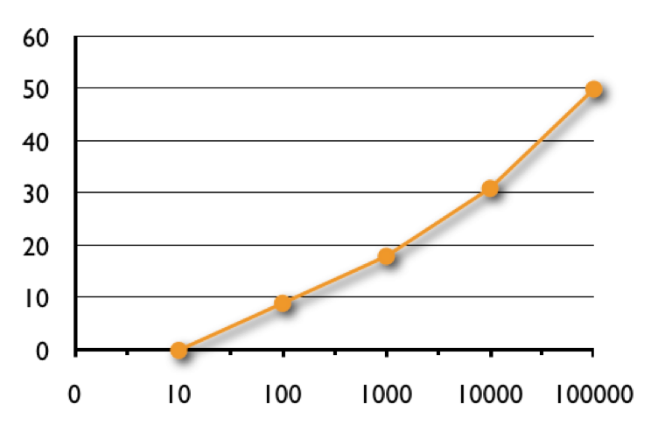
Most requirements defined early
Requirements change(%) vs. Project size (function points)

Slide 8
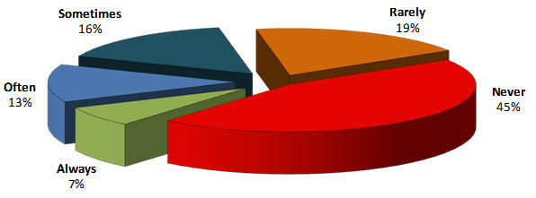
Not all requirements are worth developing
Requirements used …

Slide 9
Tests in the development process > Types of tests

Slide 10
By kind of CUT (Component Under Test)
Unit tests
Interaction tests
Component tests
Integration tests
Functional (acceptance) tests

Slide 11
By granularity
Basic behavior
Unit test testing a method
Functional test testing a limited functionality
Global behavior
Unit test testing the lifecycle of an object
Functional test testing a use case scenario

Slide 12
By objective
Regression test
Requirement verification test
Acceptance test

Slide 13
By design strategy of the test
Test derived from a specification
Test derived from an implementation
Hybrid test

Slide 14
Tests in the development process > Test Architectures

Slide 15
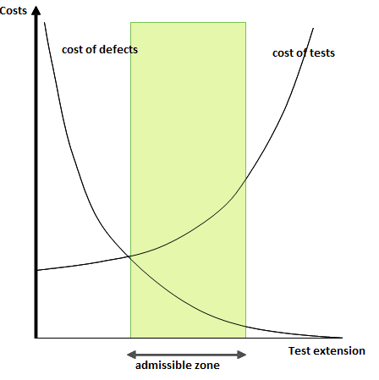
Test strategies
“One of the most difficult problems in testing is knowing when to stop” (Myers, 1976)

Slide 16
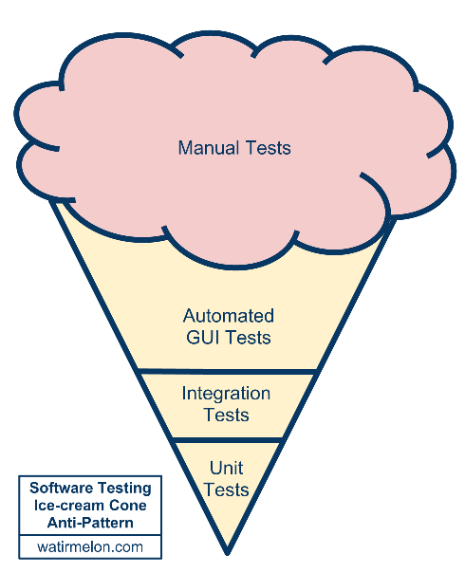
Traditional test architecture

Slide 17
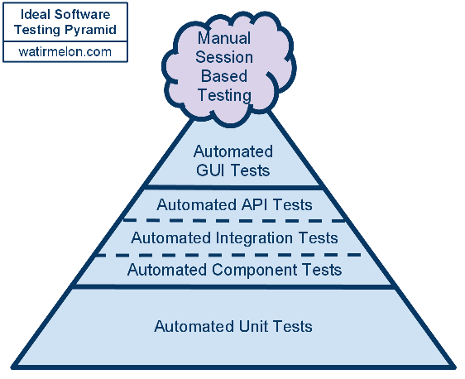
A well behaved test architecture

Slide 18
Tests in the development process > AGILE Programming

Slide 19
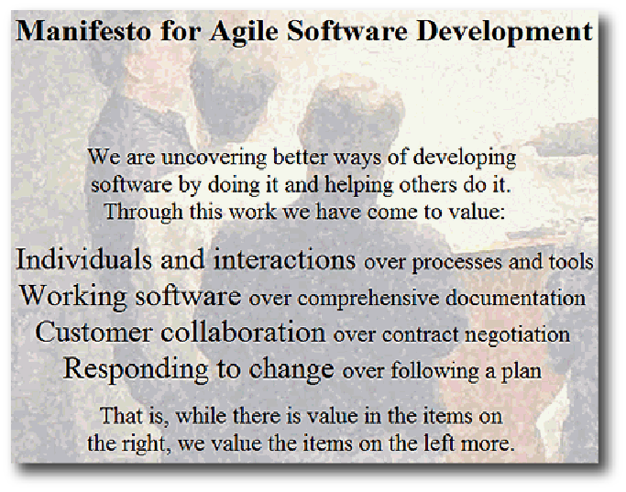
Agile Manifesto
February 2001, Snowbird, Utah, USA

Slide 20
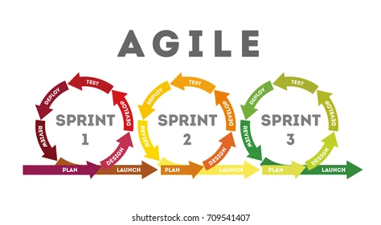
AGILE Sprint Lifecyle

Slide 21

User Stories : definition
A short description of a feature that is a source of value for the product user or customer
Place a job offer
As a recruiter I can place job offers to hire new staff
Est: 5
Pri: 1

Slide 22
User Stories : characteristics
INVEST
Independent
Negotiable
Valuable
Estimable
Sized appropriately or Small
Testable
Jeffrey’s 3C
Card
Conversation
Confirmation

Slide 23
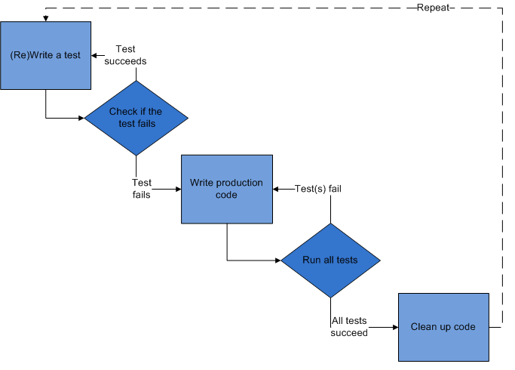
Test Driven Development in Java
Automated tests with the JUnit framework

Slide 24
Junit : Main characteristics
Framework for automated tests
Integrated with IDEs
Integrated with build and evaluation tools
Many available extensions
Web : HtmlUnit, WebUnit
Databases : DbUnit

Slide 25
Test class
public class DieTest { private Die die = new Die(); // Actor : CUT @BeforeClass public static void globalSetUp() { /* common initialisations (fixtures) */ } @AfterClass public static void globalTearDown() { /*...*/ } @Before public void setUp() { /* common initialisations (fixtures) */ } @After public void tearDown() { /*...*/ } @Test public void should_have_value_between_1_and_6() { // Initailisations specific to the test die.roll(); // Actions on Actors assertTrue(die.getFaceValue() >= 1); // Assertions assertTrue(die.getFaceValue() <= 6); } }

Slide 26
More on test classes…
public class TestDatabase {
private Database db;
@Test(expected=NoDatabaseException.class)
public void unavailableDatabase() throws NoDatabaseException {
connect("unknown");
}
@Test(timeout=10)
public void connectionInLessThan10ms() throws NoDatabaseException {
connect("db");
}
}

Slide 27
Parameterized tests
@RunWith(Parameterized.class)
public class ParameterizedSquareTest {
private int n, squareN;
public ParameterizedSquareTest(int n, int squareN) {
this.n = n;
this.squareN = squareN;
}
@Parameters(name = "{index}: square({i0})={1}")
public static Collection data() {
return Arrays.asList( new Object[][] {
{ 0,0 },{ 1,1 },{ 2,4 },{ 3,9} });
}
@Test public void squareNIsNTimesN() {
assertThat(squareN, is(n*n));
}
}

Slide 28
Test Driven Development in Java
Principles of TDD

Slide 29

The development cycle of TDD
Red
Green
Refactoring
Done in micro-iterations

Slide 30
TDD best practices
Test First
Assert First
Tests as specifications
Refactoring

Slide 31
Test Driven Development in Java
Test writing strategies

Slide 32
Test selection strategies
Test selection strategies
Test passing strategies

Slide 33
INVEST … for tests
Self similarity with User Stories
At a lower granularity
Developing a class is a “Developer Story”
Tests should be
Isolated
Negotiable
Estimable
We should be able to estimate de development time to work in short steps
Small enough, but not trivial
Testable
We first make it fail

Slide 34
Test selection patterns
Test List
Another Test
One Step Test
Learning Test
Starter Test
Regression Test
See http://baphled.wordpress.com/2009/01/28/tdd-patterns/

Slide 35
Test passing strategies
Test selection strategies
Test passing strategies

Slide 36
Test passing strategies
Fake it
Triangulation
Trivial Implementation
One to many
Flexible, Reliable Software Using Patterns and Agile Development (Henrik B. Christensen) Chapter 5
http://www.baerbak.com/chap5.pdf

Slide 37
Summary
Resources
Flexible, Reliable Software Using Patterns and Agile Development (Henrik B. Christensen) Chapter 5
http://www.baerbak.com/chap5.pdf
TDD Patterns
http://baphled.wordpress.com/2009/01/28/tdd-patterns/

Slide 38
Test Driven Development in Java
Writing testable code

Slide 39
General principles
General principles
Domain Driven Design

Slide 40
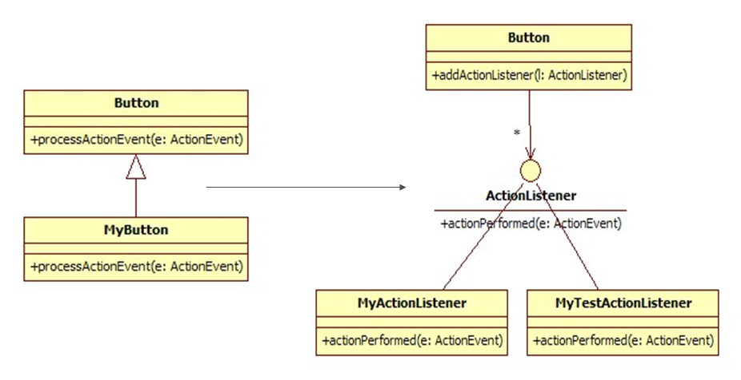
Design Principles
Favor composition over inheritance
Program to an interface, not an implementation

Slide 41
Avoid the Singleton and static code
public class EmployeeDAO {
public void save(Employee e) {
Database db = Database.getInstance();
...
}
}
Isolate dependencies
public class EmployeeDAO {
public void save(Employee e) {
Database db = getDatabase();
...
}
protected Database getDatabase() { return Database.getInstance(); }
}
public class EmployeeDAOTest {
@Test public void testWithIsolatedDependencies() {
EmployeeDAO dao = new EmployeeDAO() {
protected Database getDatabase() { return new FakeDatabase(); }
};
}
}

Slide 42
Dependency injection
public class EmployeeDAO {
Database database;
public void setDatabase(Database db) { database = db; }
public void save(Employee e) {
// Utiliser database
}
}
public class EmployeeDAOTest {
@Test public void testWithDependencyInjection{
EmployeeDAO dao = new EmployeeDAO();
Database db = new FakedDatabase ();
dao.setDatabase(db);
…
}
}

Slide 43
Domain Driven Design
General principles
Domain Driven Design

Slide 44
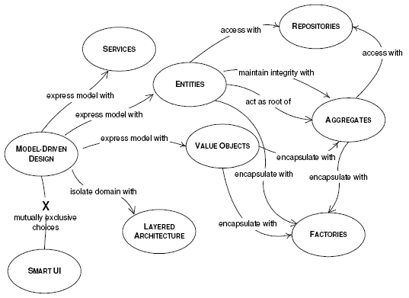
Structure Patterns

Slide 45
Test Driven Development in Java
Test doubles

Slide 46
What are test doubles ?
What are test doubles ?
Kinds of doubles

Slide 47
When to use test doubles ?
Test doubles replace the real thing
For unit tests of CUTs having dependencies on other unusable components

Slide 48
Kinds of doubles
What are test doubles ?
Kinds of doubles

Slide 49
Functional doubles
Dummy Object
Simplest form of a test double.
Provides a default value where required
http://xunitpatterns.com/Dummy Object.html
Stub
Adds simplistic logic to a dummy, providing different outputs
http://xunitpatterns.com/Test Stub.html
Fake
Comprehensive component providing a higher-fidelity approximation of the target capability
http://xunitpatterns.com/Fake Object.html

Slide 50
Observation doubles
Spy
Captures and makes available parameter and internal state information
Allows for more advanced state validation
http://xunitpatterns.com/Test Spy.html
Mock
Specified by an individual test case to validate test-specific behavior, checking how the double has been used (parameter values and call sequencing)
http://xunitpatterns.com/Mock Object.html

Slide 51
Example : a Cup
public class Die {
private int value;
public int getValue() { return -1; }
public void roll() { }
}
public class Cup {
private Die die1;
private Die die2;
public Cup(Die die1, Die die2) {
if (die1 == null || die2 == null)
throw new IllegalArgumentException();
this.die1 = die1; this.die2 = die2;
}
int getValue() {
return die1.getValue() + die2.getValue();
}
public void roll() {
die1.roll(); die2.roll();
}
}

Slide 52
Dummy
@Test
public void dummyDie() {
Die die = new Die() {
public int getValue() {
return 0;
}
};
Cup cup = new Cup(die, die);
// use cup
}

Slide 53
Stub
@Test
public void stubDice() {
class StubDie extends Die {
private int stubValue;
public StubDie(int stubValue) {
this.stubValue = stubValue;
}
public int getValue() {
return stubValue;
}
}
Die die1 = new StubDie(1);
Die die2 = new StubDie(2);
Cup cup = new Cup(die1, die2);
assertThat(cup.getValue(), is(1 + 2));
}

Slide 54
Fake
@Test
public void fakeDice() {
class FakeDie extends Die {
private int fakeValue;
public FakeDie(int stubValue) { this.fakeValue = stubValue; }
public int getValue() { return fakeValue; }
public void roll() { fakeValue = fakeValue % 6 + 1; }
}
Die die1 = new FakeDie(1);
Die die2 = new FakeDie(2);
Cup cup = new Cup(die1, die2);
assertThat(cup.getValue(), is(1 + 2));
cup.roll();
assertThat(cup.getValue(), is(2 + 3));
}

Slide 55
Mock with Mockito
public class CupTest {
private Die die = mock(Die.class);
private Cup cup = new Cup(die, die);
@Test public void valueIsTheSumOfTwoDice() {
when(die.getValue()).thenReturn(1, 2);
assertThat(cup.getValue(), equalTo(1 + 2));
}
@Test public void rollsDice() {
cup.roll();
verify(die, times(2)).roll();
}
@Test public void detectsDoubles() {
when(die.getValue()).thenReturn(1, 2);
assertThat(cup.isDouble(), is(false));
when(die.getValue()).thenReturn(1, 1);
assertThat(cup.isDouble(), is(true));
}
}

Slide 56
Implementation options
Use a class
Use an anonymous / local / inner class
Use self-shunt
Use a mock library
All kind of doubles may be implemented with these approaches

Slide 57
Summary
Resources
Mockito
http://docs.mockito.googlecode.com/hg/latest/org/mockito/Mockito.html
xUnit test doubles
http://xunitpatterns.com/Test Double.html
Fakes, mocks and integration tests (Wikipedia)
http://en.wikipedia.org/wiki/Test-driven_development#Fakes.2C_mocks_and_integration_tests
Mocks Aren't Stubs (Martin Fowler)
http://martinfowler.com/articles/mocksArentStubs.html

Slide 58
Test Driven Development in Java
Techniques to organize tests

Slide 59
Organizing test classes
Organizing test classes
Organizing test code

Slide 60
Testcase Class
Testcase Class per Class
A good starting point
For few test methods
http://xunitpatterns.com/Testcase Class per Class.html
Testcase Class per Fixture
Groups of test methods that need an identical fixture
Keep each test method as simple as possible
http://xunitpatterns.com/Testcase Class per Fixture.html

Slide 61
Testcase Superclass
Test case Superclass as a reuse of test utility methods between several Testcase Subclasses
http://xunitpatterns.com/Testcase Superclass.html

Slide 62
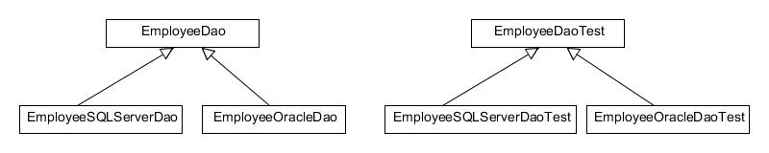
Testing inheritance
The superclass may be viewed as a “partial specification” of the subclasses
Some tests may be factored in the superclass
Some tests must be redefined in the subclasses
Additional tests may be required

Slide 63
Organizing test code
Organizing test classes
Organizing test code

Slide 64
Test Helper
A class to hold any test utility methods we want to reuse in several tests
http://xunitpatterns.com/Test Helper.html
Variation : Object Mother
Helper that provides factory methods that tests use to create ready-to-use test fixture objects.
May also include the ability to delete the objects it creates.

Slide 65
Test using a Data Builder
import static orders.OrderBuilder.*;
import static orders.CustomerBuilder.*;
public class OrderTest {
private static final String CUSTOMER_NAME = "Daniel";
private static final double ITEM_PRICE = 32;
private static final int ITEM_QUANTITY = 1;
private static final String ITEM_NAME = "Growing Object-Oriented Software";
private OrderBuilder anOrder;
@Before
public void setUp() {
anOrder = anOrder().from(aCustomer().called(CUSTOMER_NAME)).with(
anOrderLineOf(ITEM_NAME, ITEM_QUANTITY, ITEM_PRICE));
}
@Test
public void chargesCustomerForCostOfASingleItemWithDiscount() {
final double fortyPercent = 0.4;
OrderBuilder anOrderWithDiscount = anOrder
.withADiscountOf(fortyPercent);
Order order = anOrderWithDiscount.build();
assertThat(order.charge(), is(equalTo(ITEM_PRICE * fortyPercent)));
}
}

Slide 66
Data Builder implementation
public class OrderBuilder {
private CustomerBuilder customerBuilder;
private double discountRate;
private List<OrderLine> orderLines = new ArrayList<OrderLine>();
public static OrderBuilder anOrder() {
return new OrderBuilder();
}
public static OrderLine anOrderLineOf(String itemName, int quantity, double price) {
return new OrderLine(itemName, quantity, price);
}
public OrderBuilder from(CustomerBuilder customerBuilder) {
OrderBuilder cloneOrder = deepCopy();
cloneOrder.customerBuilder = customerBuilder;
return cloneOrder;
}
public OrderBuilder withADiscountOf(double discountRate) {
OrderBuilder cloneOrder = deepCopy();
cloneOrder.discountRate = discountRate;
return cloneOrder;
}
public OrderBuilder with(OrderLine orderLine) {
OrderBuilder cloneOrder = deepCopy();
cloneOrder.orderLines.add(orderLine);
return cloneOrder;
}
public Order build() {
Order order = new Order(customerBuilder.build());
order.setDiscountRate(discountRate);
for (OrderLine orderLine : orderLines) {
order.addOrder(orderLine);
}
return order;
}
private OrderBuilder deepCopy() {
OrderBuilder cloneOrder = …;
return cloneOrder;
}
}

Slide 67
Test Driven Development in Java
TDD and legacy code

Slide 68
What is legacy code ?
What is legacy code ?
Legacy Management Strategy
PowerMock

Slide 69
What is legacy code ?
“Any 3rd party system that I have to integrate with was written by a drunken monkey typing with his feet. “
Oren Eini (ayende.com)
“For people who deal with it day in and day out legacy code" is a Pandora's box: sleepless nights and anxious days poring through bad structure, code that works in some incomprehensible way, days adding features with no way of estimating how long it will take. The age of the code has nothing to do with it. People are writing legacy code right now, maybe on your project”
Working Effectively With Legacy Code - Michael Feathers
http://www.objectmentor.com/resources/articles/WorkingEffectivelyWithLegacyCode.pdf

Slide 70
How to deal with legacy code ?
“The main thing that distinguishes legacy code from non-legacy code is tests, or rather a lack of tests”
Michael Feathers
Bring the code to a place where you know how to make changes like in TDD, one at a time

Slide 71
Test Coverings
A set of tests used to introduce an invariant on a code base
Tend to cover the behavior of a set of classes rather than just a class and its immediate collaborators
Interaction tests
Correct behavior is defined by what the set of classes did yesterday
Work backwards vs. TDD

Slide 72
Legacy Management Strategy
What is legacy code ?
Legacy Management Strategy
PowerMock

Slide 73
Legacy Management Strategy
Management Strategy
Identify change points
Find test points
Break dependencies
Write tests
Make changes and refactor the covered code
Depends on status
In production -> take less risks
not in production -> bugs introduced may remain unnoticed

Slide 74
Identify change points
If there are multiple ways of making the changes choose the way which requires the fewest changes

Slide 75
Find an inflection point
A change on any of the classes behind an inflection point is either detectable at the inflection point, or inconsequential in the application
Find "functional" invariants

Slide 76
Cover the inflection point
Break external dependencies
Dependency inversion
Break internal dependencies
Dependency isolation
Mock static, final and private methods
PowerMockito
Write tests

Slide 77
Make changes
Write new tests as required

Slide 78
Refactor the covered code
Listen to your code
Use one step refactorings as required
Find hierarchical calls
Possibly split classes
Write new tests as required
Your code testability should improve
Extract Testable Component
http://xunitpatterns.com/Extract%20Testable%20Component.html

Slide 79
PowerMock
What is legacy code ?
Legacy Management Strategy
PowerMock

Slide 80
An example of using PowerMock
public class Fibonacci {
public int fib(int n) {
return doFib(n);
}
private int doFib(int n) {
return StaticFibonacci.fib(n);
}
}
…
public class StaticFibonacci {
public static int fib(int n) {
if (n==0)
return 0;
else if (n==1)
return 1;
else
return fib(n-1) + fib(n-2);
}
}

Slide 81
Test with private methods
import org.powermock.api.mockito.PowerMockito;
import org.powermock.core.classloader.annotations.PrepareForTest;
import org.powermock.modules.junit4.PowerMockRunner;
@RunWith(PowerMockRunner.class)
@PrepareForTest(Fibonacci.class)
public class PrivateFibonacciTest {
@Test
public void testPrivate() throws Exception {
Fibonacci fib = PowerMockito.spy(new Fibonacci());
PowerMockito.doReturn(25).when(fib, "doFib", 0);
assertThat(fib.fib(0), equalTo(25));
}
}

Slide 82
Test with static methods
import org.powermock.api.mockito.PowerMockito;
import org.powermock.core.classloader.annotations.PrepareForTest;
import org.powermock.modules.junit4.PowerMockRunner;
@RunWith(PowerMockRunner.class)
@PrepareForTest(StaticFibonacci.class)
public class StaticFibonacciTest {
private Fibonacci fib = new Fibonacci();
@Test
public void stubStatic() {
PowerMockito.mockStatic(StaticFibonacci.class);
when(StaticFibonacci.fib(0)).thenReturn(20);
when(StaticFibonacci.fib(1)).thenReturn(21);
assertThat(fib.fib(0), equalTo(20));
assertThat(fib.fib(1), equalTo(21));
PowerMockito.verifyStatic(times(2));
StaticFibonacci.fib(anyInt());
}
}

Slide 83
Test Driven Development in Java
TDD coverage

Slide 84
Test axioms – Myers 1976
16 Axioms
Based on the assumptions that the developers should be the testers
“Software Reliability, Principles & Practices” - Glenford Myers, 1976
Discussed in “Back to the Beginning : Testing Axioms revisited” - Erik Petersen
http://www.testingspot.net/testref/Spot%20Beginning.pdf

Slide 85
Test axioms – Binder 1996
3 Axioms
Anti-extensionality axiom
Adequate testing of programs that have the same function but different implementation requires different test suites
Anti-decomposition axiom
Adequate testing of a program invoked or used by different callers requires a different test suite for each such context
Anti-composition axiom
Tests which are individually adequate for units of a program are not collectivelly adequate for the assembled units

Slide 86
Kinds of code coverage
Statement coverage
Lines of code executed
Multiple condition coverage
Measures whether each logical condition in the code has evaluated both true and false in some execution of the program
Tools provide coverage metrics
Should not replace thinking
But may help to find black holes of testing

Slide 87
How to use code coverage
When you find a black (or grey) hole
Examine the tests and compare them to the external description of what that part of the product is to do. Did you overlook something?
Are the tests really testing what you thought they were testing?
Talk to the developer to get an idea of what you missed. Sit by as the programmer scans the uncovered code and tells you what it does (from the user's perspective). You're looking for large patterns of missing tests.
How to Misuse Code Coverage - Brian Marick
http://www.exampler.com/testing-com/writings/coverage.pdf

Slide 88
Test Driven Development in Java
Refactoring with TDD

Slide 89
Defining refactoring
"Refactoring is a disciplined technique for restructuring an existing body of code, altering its internal structure without changing its external behavior" Martin Fowler
Series of small behavior preserving transformations

Slide 90
Why should you refactor ?
Improve design of software
Improve readability of software
“Any fool can write code that a computer can understand. Good programmers write code that humans can understand” - Martin Fowler

Slide 91
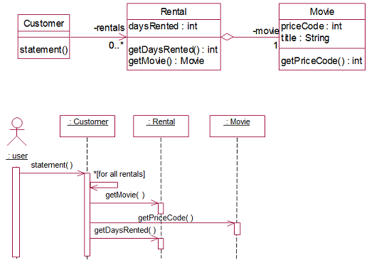
Refactoring example
Bad smells …

Slide 92
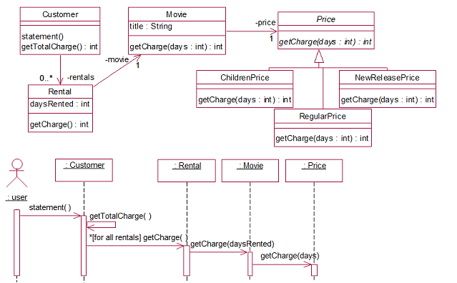
After several refactoring steps …
A strategy design pattern has been coded

Slide 93
Refactoring concepts
Bad smells in code
http://sourcemaking.com/refactoring
Bad smells in test
http://xunitpatterns.com/Test Smells.html
Refactorings
http://sourcemaking.com/refactoring

